Slide 1

“NETNet”
㈜롯데정보통신 프로젝트 교육생
지 명 화

Slide 2
목차
01 Introduction
02 NET Mechanism
03 Single-Shot Detector: NETNet
04 Experiment

Slide 3
Introduction

Slide 4
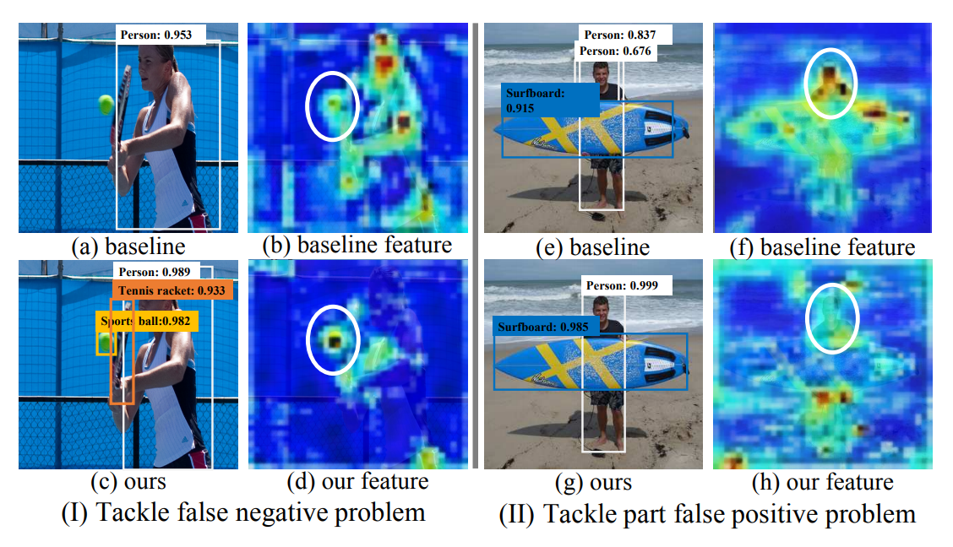
01 Introduction

Slide 5
NET Mechanism

Slide 6

02 NET Mechanism
Basic Feature Pyramid

Slide 7
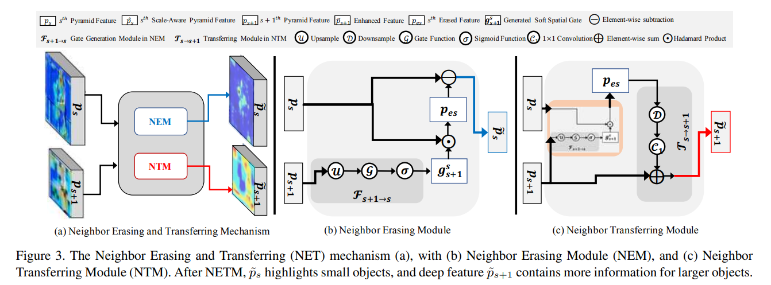
02 NET Mechanism
Neighbor Erasing Module

Slide 8



02 NET Mechanism
Neighbor Erasing Module

Slide 9

02 NET Mechanism
Neighbor Transferring Module

Slide 10
Single-Shot Detector: NETNet

Slide 11
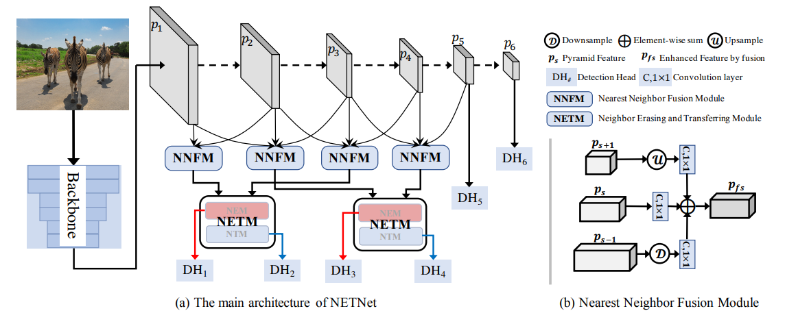
03 Single-Shot Detector: NETNet

Slide 12
Experiment

Slide 13
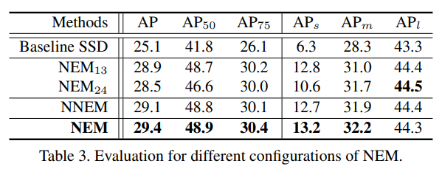
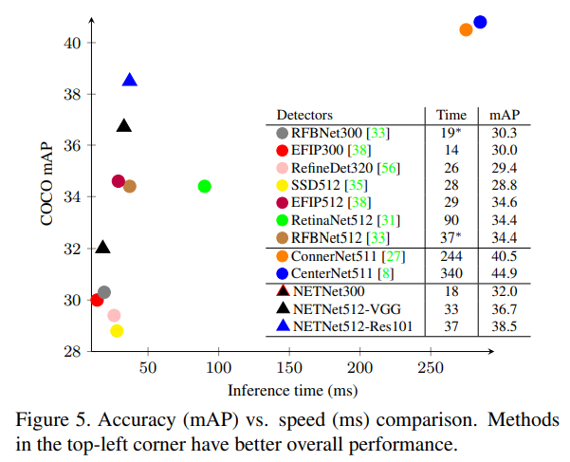
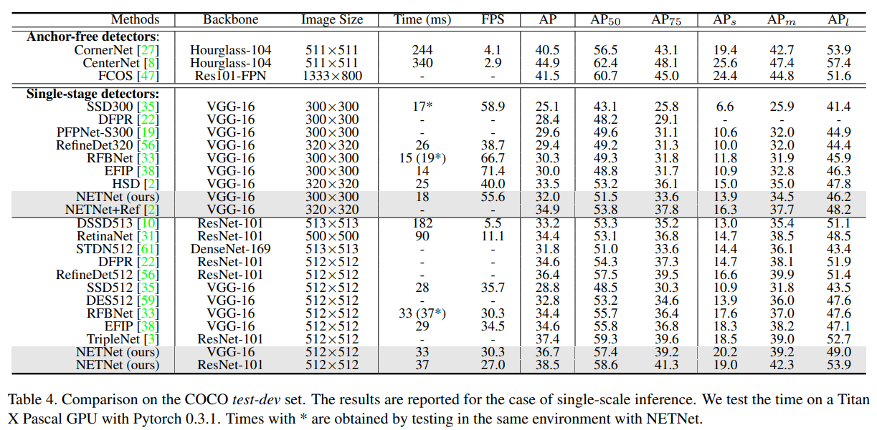
04 Experiment

Slide 14
감사합니다

